Slide 1



NEWS YOU CAN USE
Lessons on breaking the burnout cycle from a recovering TV news anchor
to help you be better at your job... and maybe your life!
CureMD Public Health User Conference 2023
Raleigh, NC

Slide 2
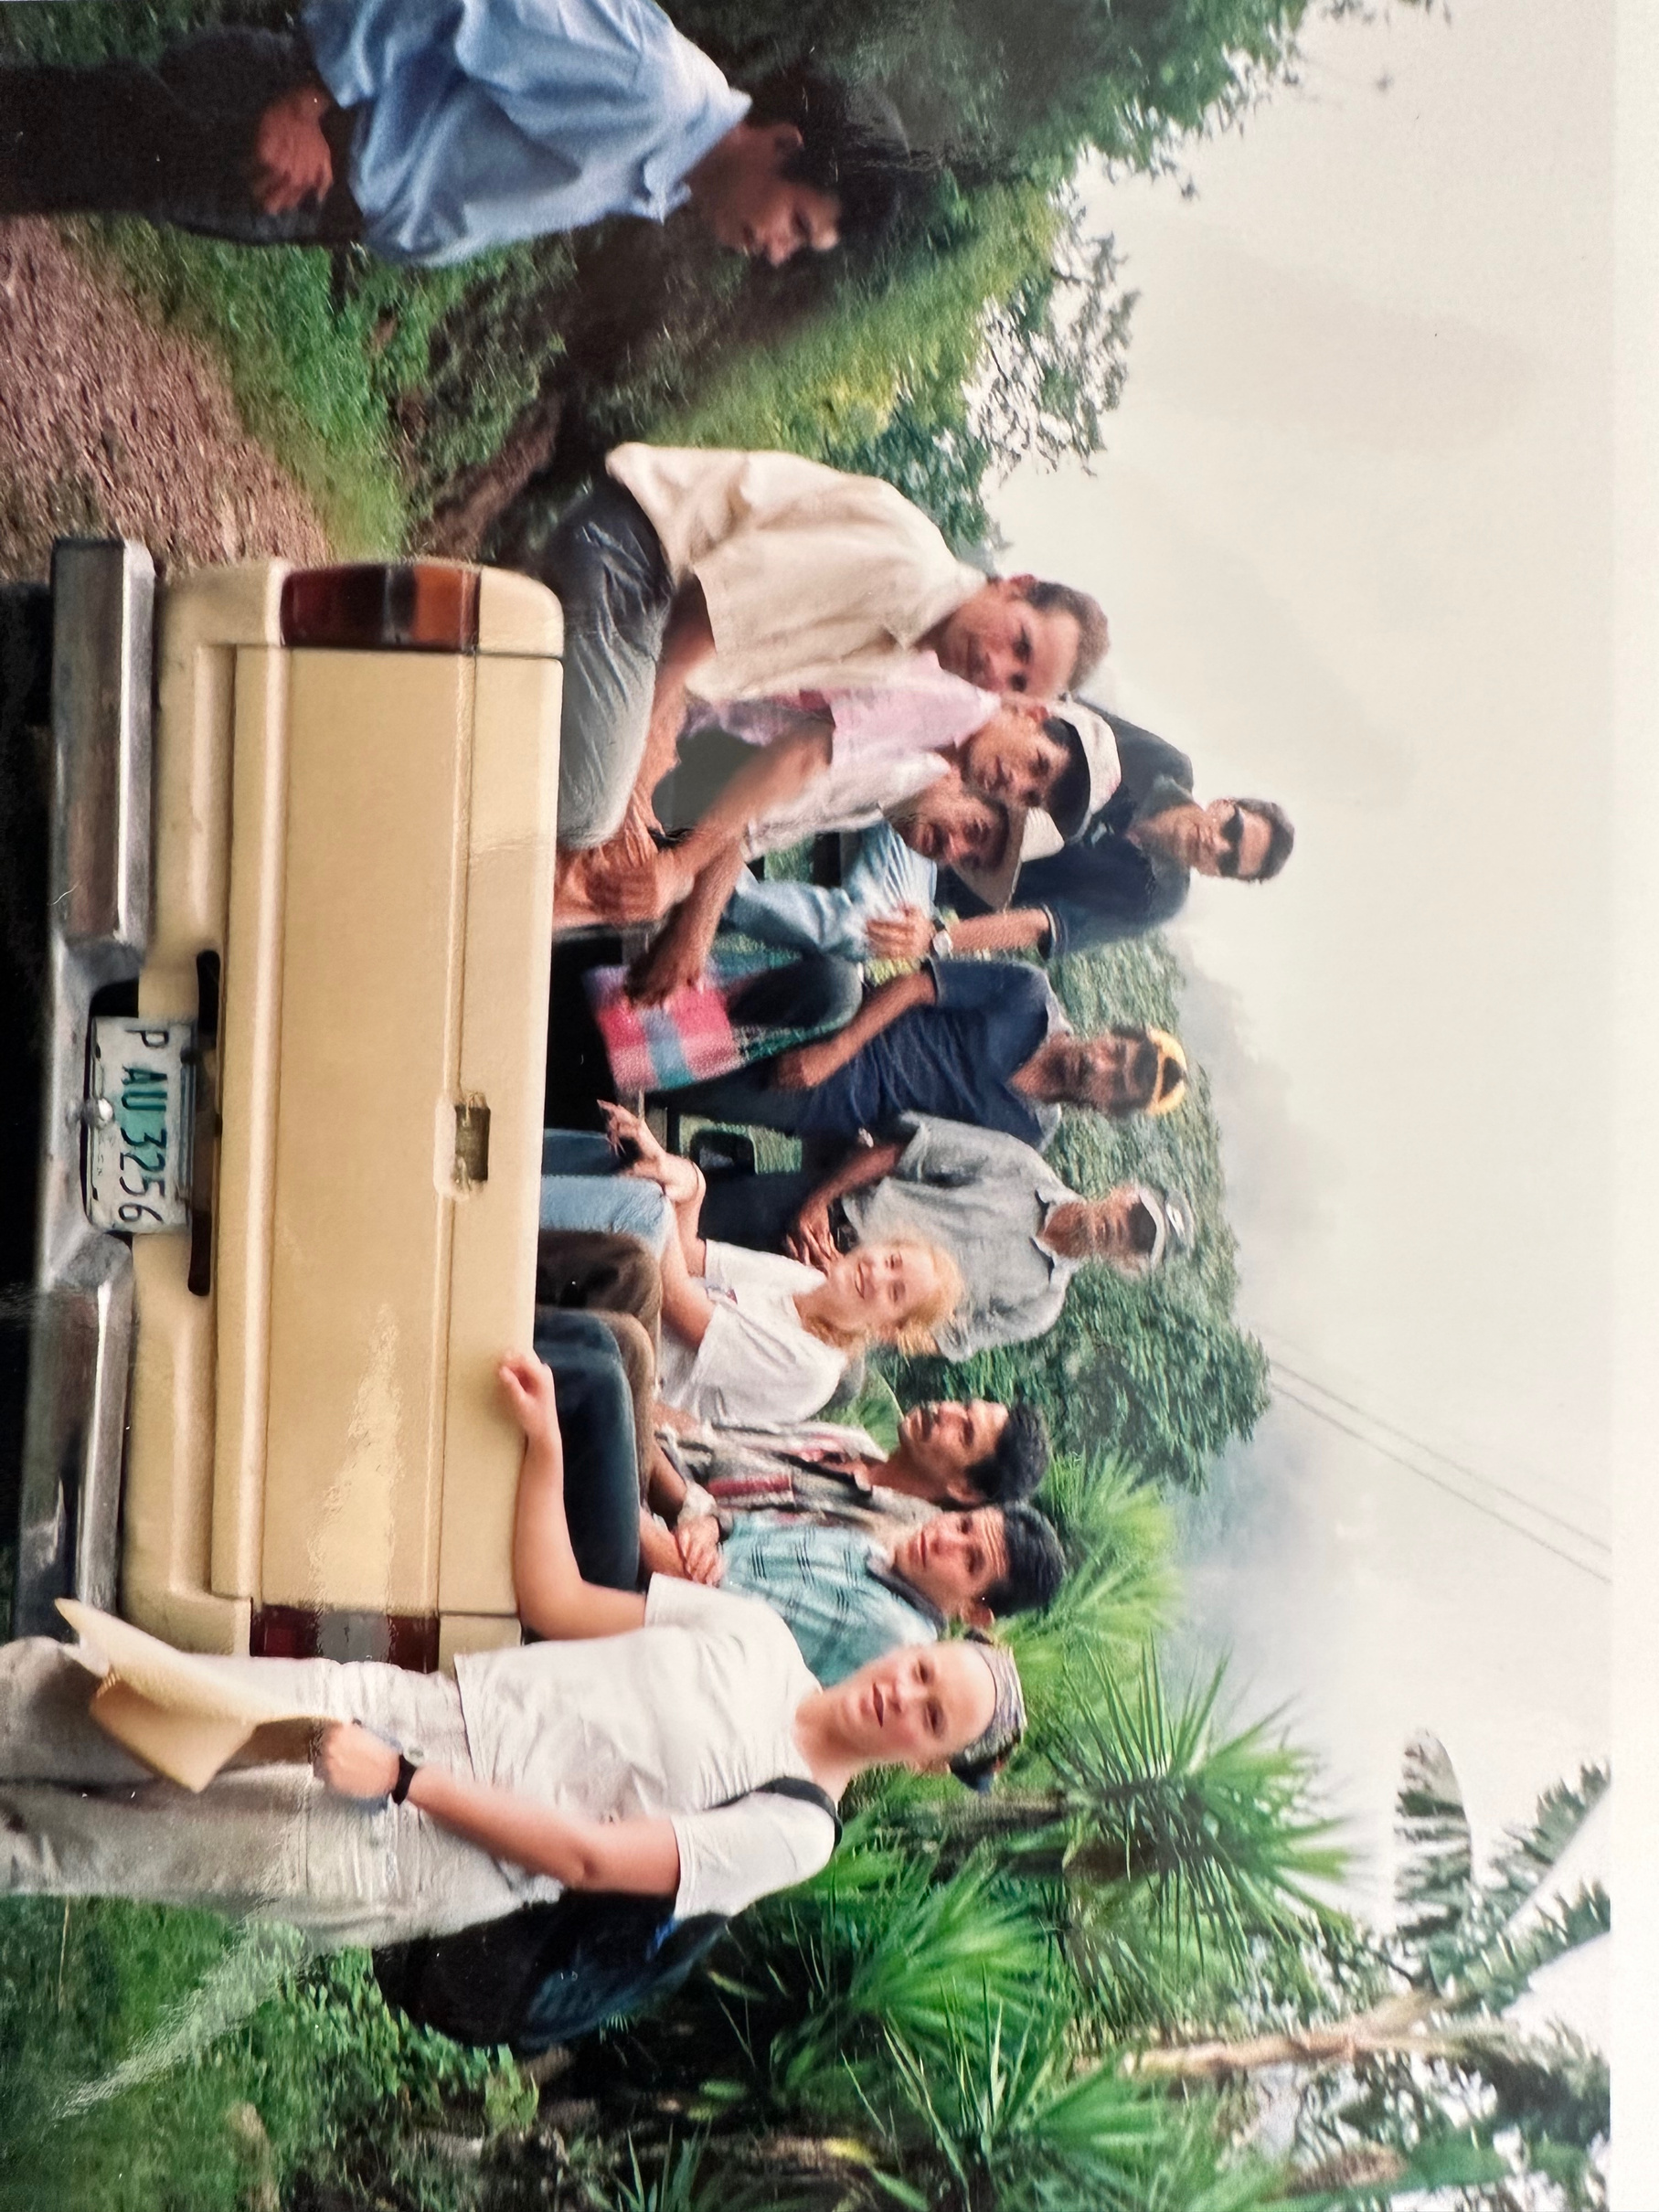

Peace Corps HONDURAS (2002)

Slide 3




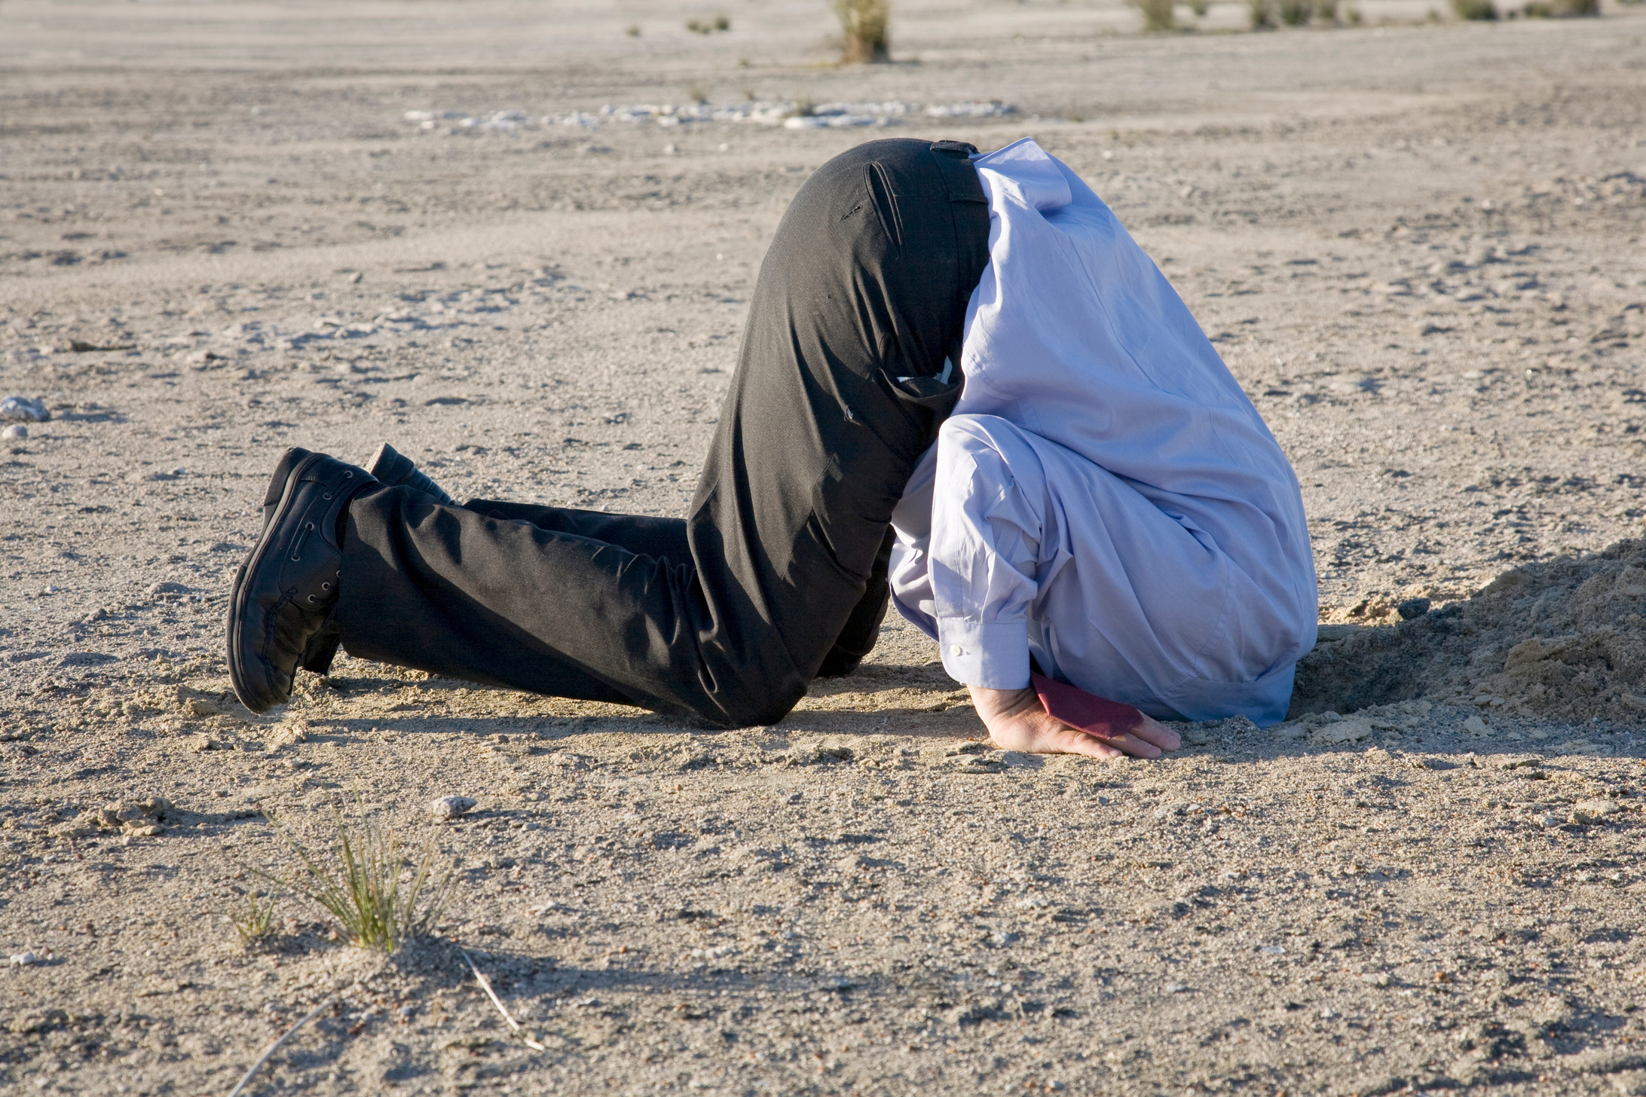
DON'T
BURY THE LEAD

Slide 4



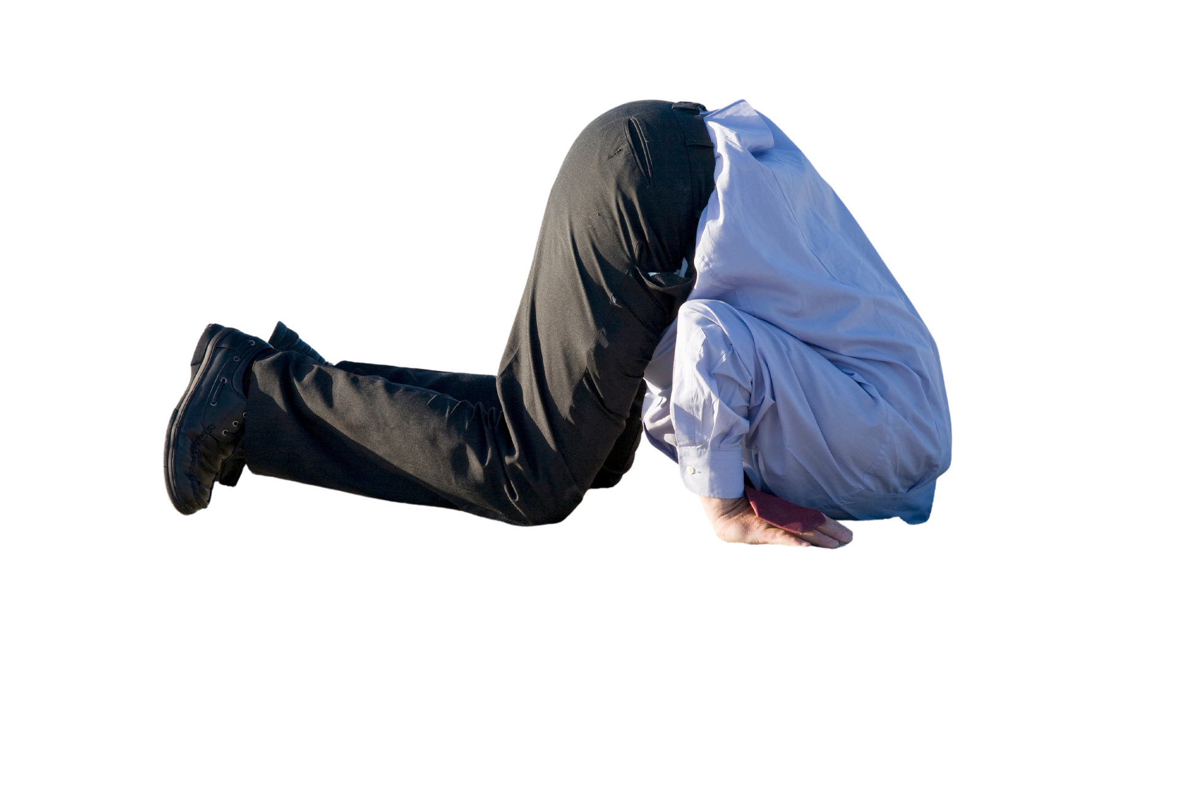
TV => IRL
DON'T BURY THE LEAD
  Conversations
  To-do list
  Inbox

Slide 5
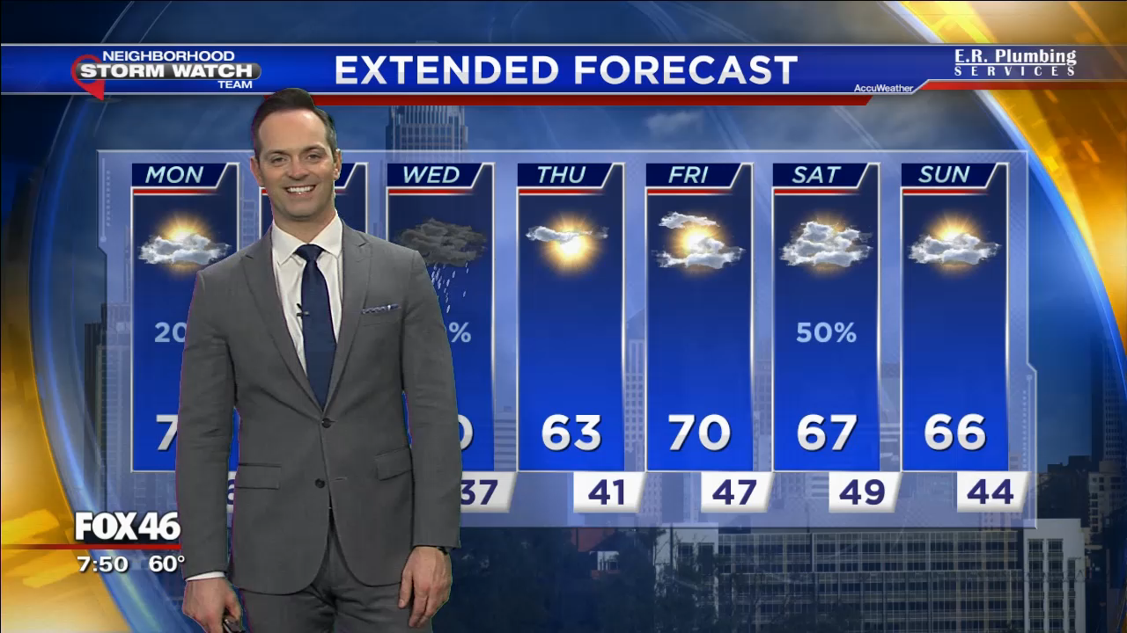

Slide 6

ALWAYS
MAKE SLOT

Slide 7

"Here's
what's happening..."

Slide 8

TV => IRL
ALWAYS MAKE SLOT
  Correspondence
  Calendars
  O.P.T.

Slide 9
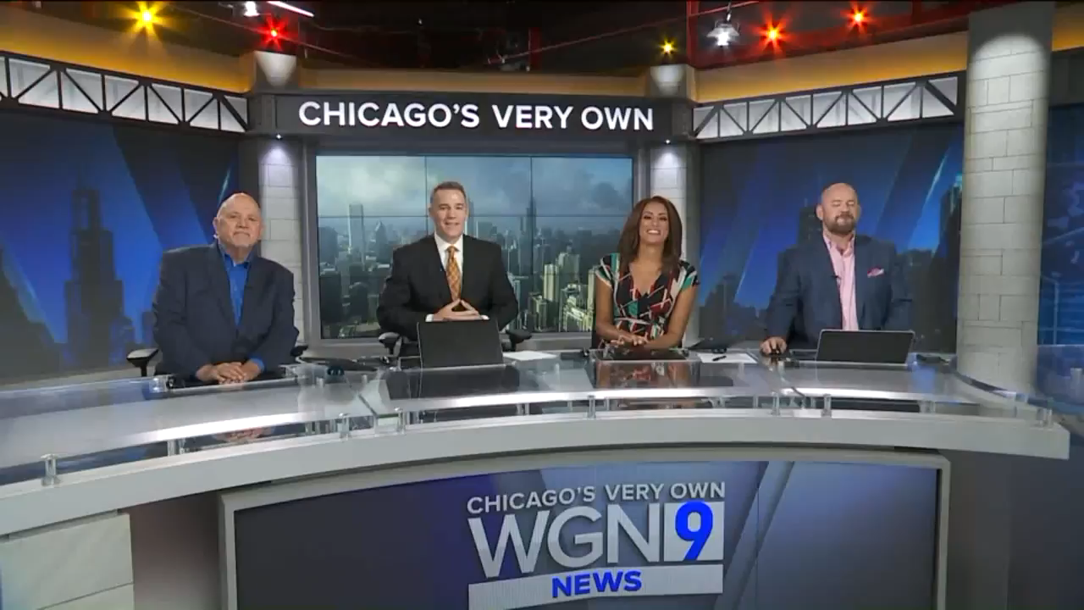

Slide 10

USE
YOUR CALL LETTERS

Slide 11
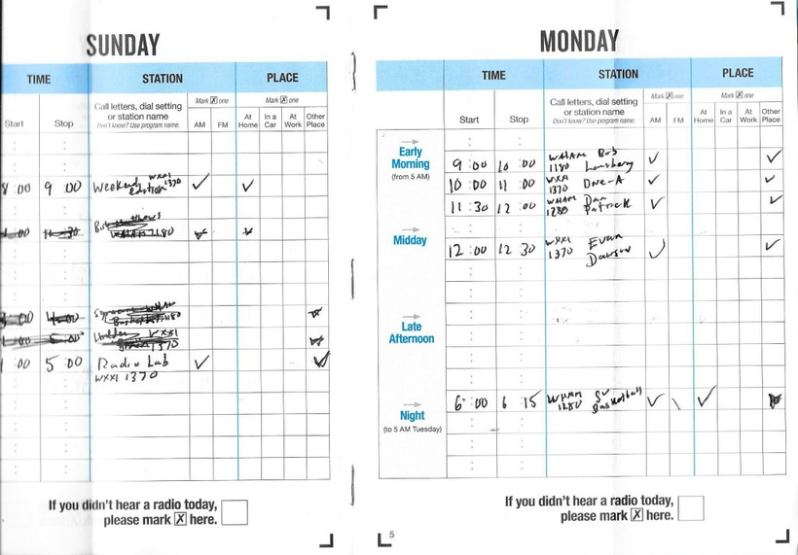
NIELSEN
DIARIES

Slide 12

TV => IRL
USE YOUR CALL LETTERS
  No, "aw shucks"
  Add value
  Delegate

Slide 13
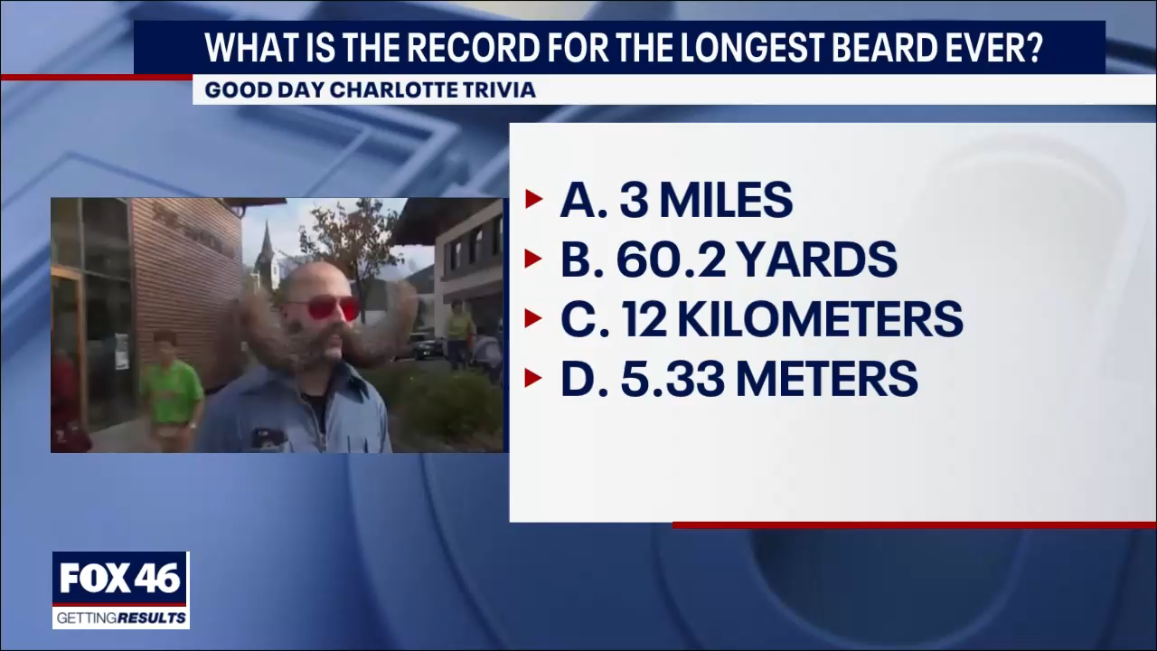

Slide 14
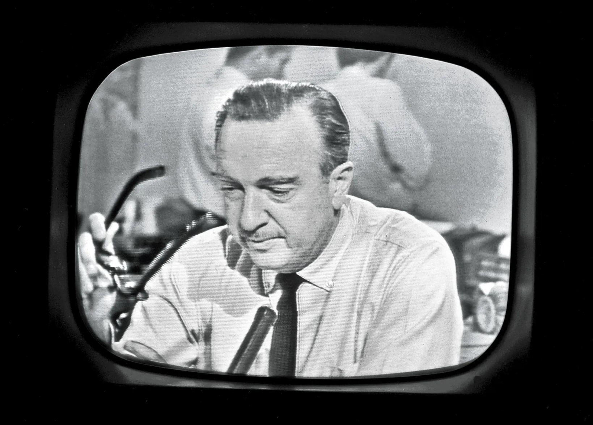
BE
CAMERA-READY

Slide 15
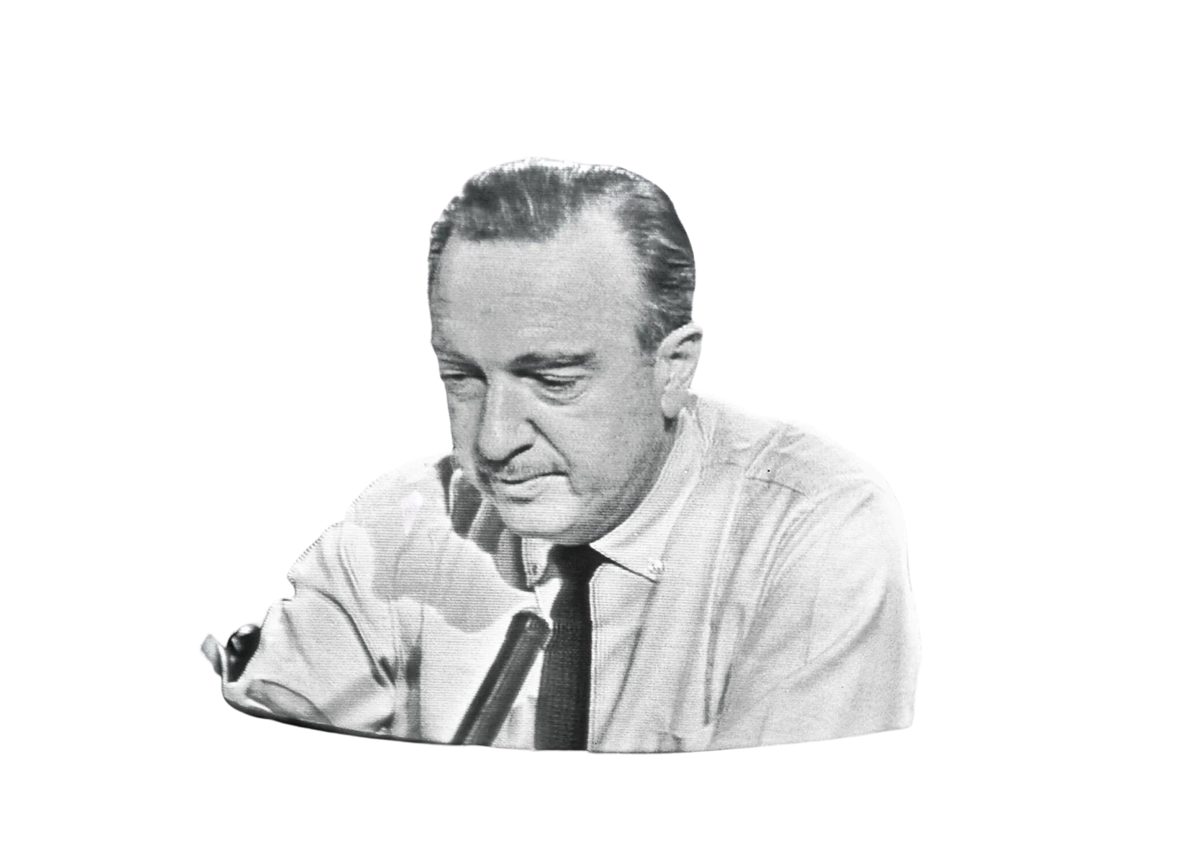
TV => IRL
BE CAMERA-READY
  Anticipate needs
  Set-up to get-up
  Surprise & delight

Slide 16
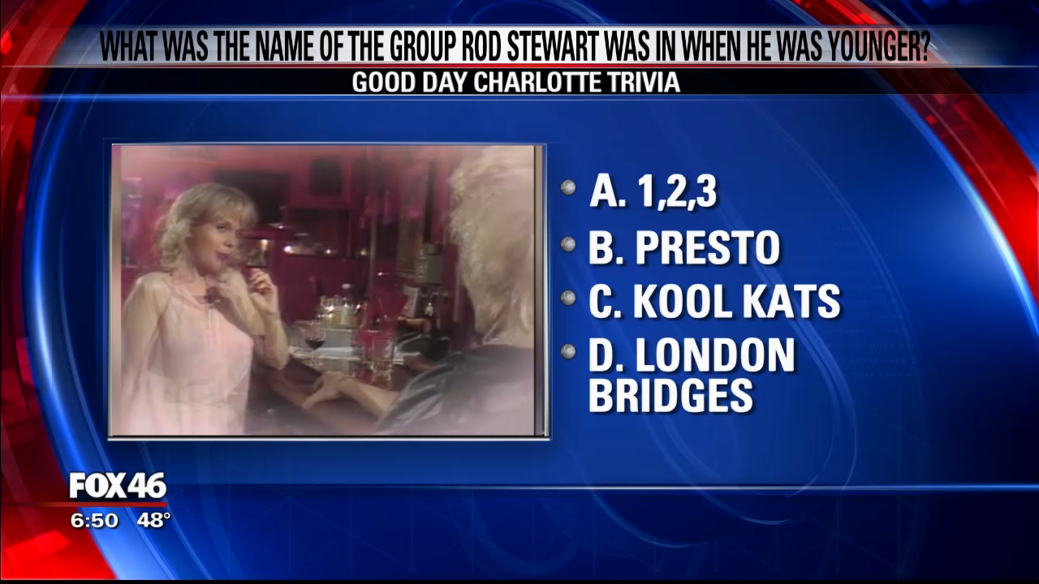

Slide 17

TAKE
COMMERCIAL BREAKS

Slide 18

TV => IRL
TAKE COMMERCIAL BREAKS
  Different strokes
  Large to small
  Model it

Slide 19


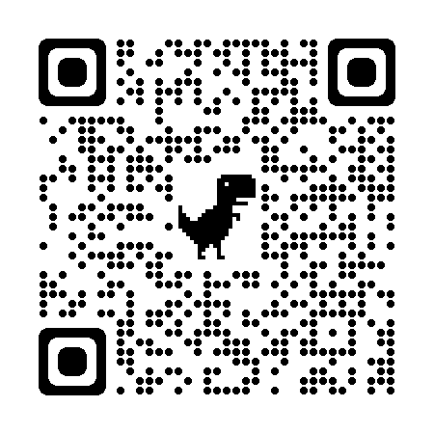






KEEP IN TOUCH!
page@pagefehling.com
(704) 497-0879
pagefehling.com
@pagefehling
/pagefehling
Date Night with Jake and Page

Slide 20
Peace Corps HONDURAS (2002)

Slide 21
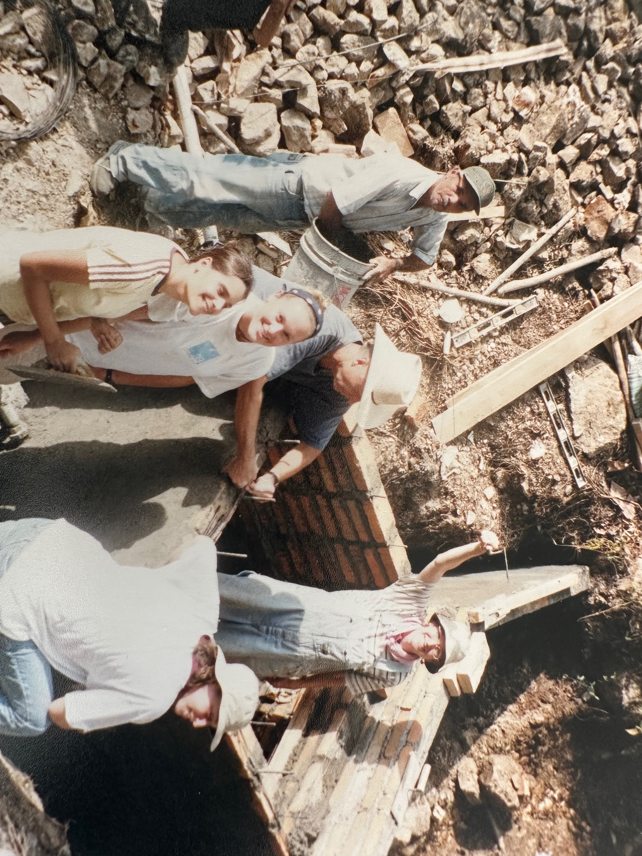
Peace Corps HONDURAS (2004)

Slide 22
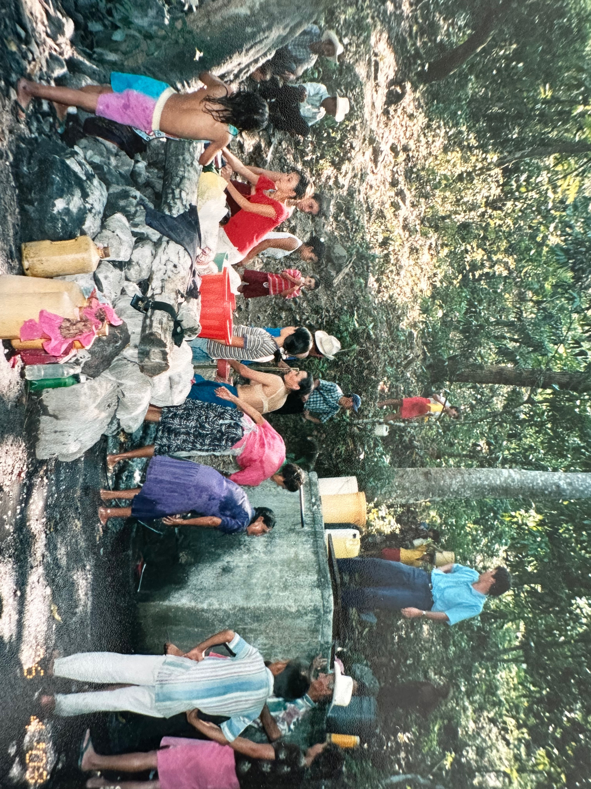
Use your news... to make an IMPACT!!!

Slide 23
THANK YOU!
page@pagefehling.com
(704) 497-0879
pagefehling.com
@pagefehling
/pagefehling
Date Night with Jake and Page

